Slide 1
PROCESS MANAGEMENT
Lecturer: Suman Thapaliya

Slide 2
Before we start
Clear meaning of System Call:
In computing, a system call is how a program requests a service from an operating system's kernel, that it does not normally have permission to run. System calls provide the interface between a process and the operating system.
This may include hardware-related services (for example, accessing a hard disk drive), creation and execution of new processes, and communication with integral kernel services such as process scheduling. System calls provide an essential interface between a process and the operating system.

Slide 3
On Unix, Unix-like and other POSIX-compliant operating systems, popular system calls are:
open, read, write, close, wait, execve, fork, exit, and kill.
Many of today's operating systems have hundreds of system calls.
For example, Linux and OpenBSD each have over 300 different calls,
NetBSD has close to 500,
FreeBSD has over 500
While Plan 9 has 51.

Slide 4
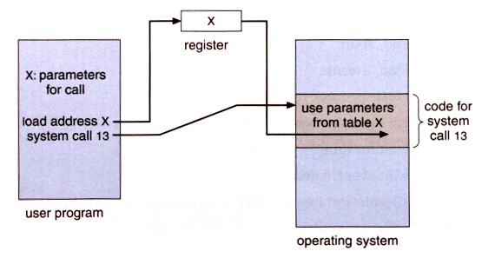
Sample to show how system call works

Slide 5
Categories of system calls
System calls can be roughly grouped into five major categories:
Process Control
load
execute
create process (for example, fork on Unix-like systems or NtCreateProcess in the Windows NT Native API)
terminate process
get/set process attributes
wait for time, wait event, signal event
allocate, free memory
File management
create file, delete file
open, close
read, write, reposition
get/set file attributes

Slide 6
Device Management
request device, release device
read, write, reposition
get/set device attributes
logically attach or detach devices
Information Maintenance
get/set time or date
get/set system data
get/set process, file, or device attributes
Communication
create, delete communication connection
send, receive messages
transfer status information
attach or detach remote devices

Slide 7
Introduction to Processes
The process model
Implementation of processes
Threads
Threads model
Thread usage
Implementing thread in user space

Slide 8
What is a Process ?
An instance of a computer program in execution.
Sometimes also called a job or task.
Processes on modern systems can have several threads of execution, or several different pieces of the program running in parallel.
Each process has its own private resources, data and associated statistics.

Slide 9
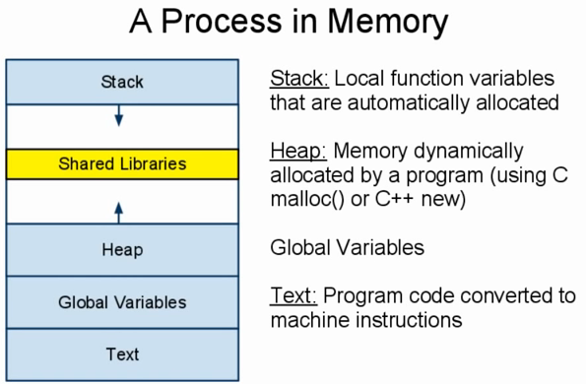

Slide 10
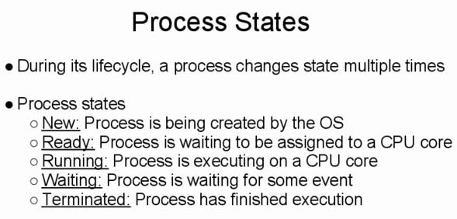

Slide 11
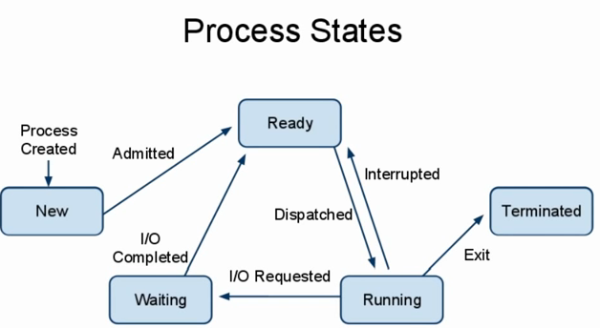

Slide 12
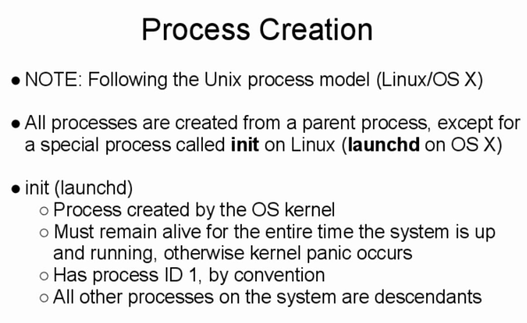

Slide 13
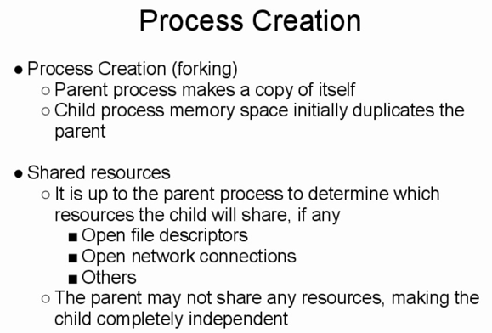

Slide 14
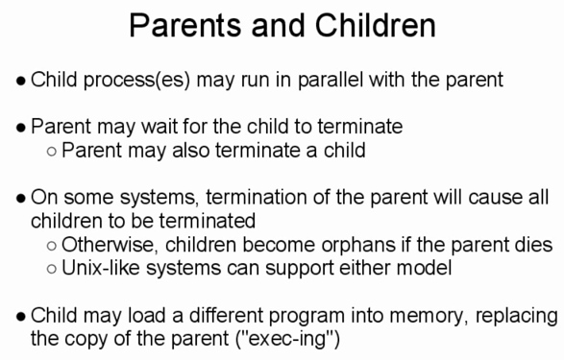

Slide 15
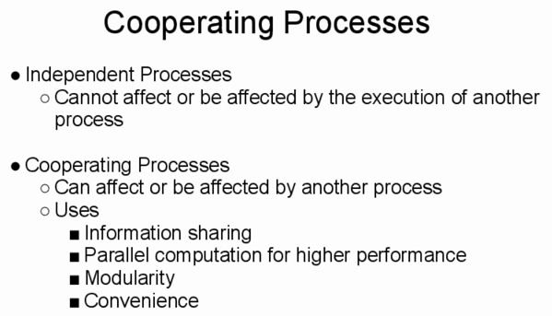

Slide 16
Introduction to Process
Process management is an integral part of any modern-day operating system (OS). The OS must allocate resources to processes, enable processes to share and exchange information, protect the resources of each process from other processes and enable synchronization among processes. To meet these requirements, the OS must maintain a data structure for each process, which describes the state and resource ownership of that process, and which enables the OS to exert control over each process.

Slide 17
Process Creation
Operating systems need some ways to create processes. In a very simple system designed for running only a single application (e.g., the controller in a microwave oven), it may be possible to have all the processes that will ever be needed be present when the system comes up. In general-purpose systems, however, some way is needed to create and terminate processes as needed during operation. There are four principal events that cause a process to be created:
System initialization.
Execution of process creation system call by a running process.
A user request to create a new process.
Initiation of a batch job.

Slide 18
When an operating system is booted, typically several processes are created. Some of these are foreground processes, that interacts with a (human) user and perform work for them. Other are background processes, which are not associated with particular users, but instead have some specific function. For example, one background process may be designed to accept incoming e-mails, sleeping most of the day but suddenly springing to life when an incoming e-mail arrives. Another background process may be designed to accept an incoming request for web pages hosted on the machine, waking up when a request arrives to service that request.
Process creation in UNIX and Linux are done through fork() or clone() system calls. There are several steps involved in process creation. The first step is the validation of whether the parent process has sufficient authorization to create a process. Upon successful validation, the parent process is copied almost entirely, with changes only to the unique process id, parent process, and user-space. Each new process gets its own user space

Slide 19
Process Termination
Again from the outside there appear to be several termination mechanism.
Normal exit (voluntary).
Error exit (voluntary).
Fatal error (involuntary).
Killed by another process (involuntary).
And again, internally the situation is simpler. In Unix terminology, there are two system calls kill and exit that are used. Kill (poorly named in my view) sends a signal to another process. If this signal is not caught (via the signal system call) the process is terminated. There is also an ``uncatchable'' signal. Exit is used for self termination and can indicate success or failure.

Slide 20
Process Termination
There are many reasons for process termination:
Batch job issues halt instruction
User logs off
Process executes a service request to terminate
Error and fault conditions
Normal completion
Time limit exceeded
Memory unavailable
Bounds violation; for example: attempted access of (non-existent) 11th element of a 10-element array
Protection error; for example: attempted write to read-only file
Arithmetic error; for example: attempted division by zero
Time overrun; for example: process waited longer than a specified maximum for an event
I/O failure
Invalid instruction; for example: when a process tries to execute data (text)
Privileged instruction
Data misuse
Operating system intervention; for example: to resolve a deadlock
Parent terminates so child processes terminate (cascading termination)
Parent request
Fatal error

Slide 21
Process Hierarchies
Modern general purpose operating systems permit a user to create and destroy processes.
In unix this is done by the fork system call, which creates a child process, and the exit system call, which terminates the current process.
After a fork both parent and child keep running (indeed they have the same program text) and each can fork off other processes.
A process tree results. The root of the tree is a special process created by the OS during startup.
A process can choose to wait for children to terminate. For example, if C issued a wait() system call it would block until G finished.
Old or primitive operating system like MS-DOS are not multiprogrammed so when one process starts another, the first process is automatically blocked and waits until the second is finished.

Slide 22
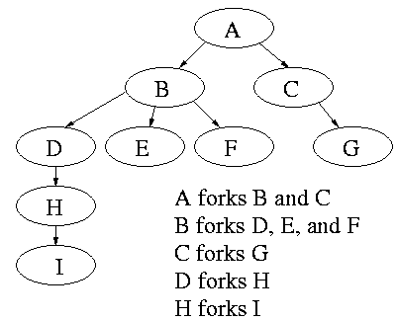

Slide 23
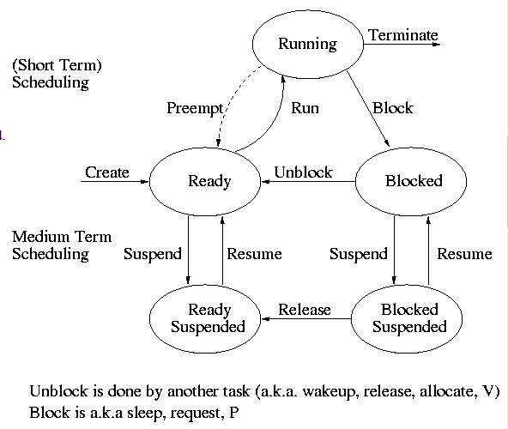
Graphical Presentation

Slide 24
Process State and Transitions
The diagram on the right contains much information.
Consider a running process P that issues an I/O request
The process blocks
At some later point, a disk interrupt occurs and the driver detects that P's request is satisfied.
P is unblocked, i.e. is moved from blocked to ready
At some later time the operating system looks for a ready job to run and picks P.
A preemptive scheduler has the dotted line preempt; A non-preemptive scheduler doesn't.
The number of processes changes only for two arcs: create and terminate.
Suspend and resume are medium term scheduling
Done on a longer time scale.
Involves memory management as well.
Sometimes called two level scheduling.

Slide 25
Implementation of Process
The OS organizes the data about each process in a table naturally called the process table. Each entry in this table is called a process table entry (PTE) or process control block.
One entry per process.
The central data structure for process management.
A process state transition (e.g., moving from blocked to ready) is reflected by a change in the value of one or more fields in the PTE.
We have converted an active entity (process) into a data structure (PTE). Finkel calls this the level principle ``an active entity becomes a data structure when looked at from a lower level''.
The PTE contains a great deal of information about the process. For example,
Saved value of registers when process not running
Stack pointer
CPU time used
Process id (PID)
Process id of parent (PPID)
User id (uid and euid)
Group id (gid and egid)
Pointer to text segment (memory for the program text)
Pointer to data segment
Pointer to stack segment
UMASK (default permissions for new files)
Current working directory
Many others

Slide 26
Differentiate
Multitasking:
The ability to execute more than one task at the same time
Tasks sharing a common resource (like 1 CPU)
More than one task/program/job/process can reside into the same CPU at one point of time.
This ability of the OS is called multitasking.
Multiprogramming:
The allocation of a computer system and its resources to more than one concurrent application, job or user
A computer running more than one program at a time (like running Excel and Firefox simultaneously)
More than one task/program/job/process can reside into the main memory at one point of time.
This ability of the OS is called multiprogramming.

Slide 27
Multithreading:
Executing more than one thread parallel using a single processor
Multiprocessing:
Simultaneous execution of instructions by multiple processors within a single computer
A computer using more than one CPU at a time .
Multiprocessing is a generic term for the use of two or more central processing units (CPUs) within a single computer system. Ex: Super Computer
Multi programming = several programs running at a time. Like Windows..with many programs open.
Multi processing - using several processors for working..eg supercomputers

Slide 28
Multiprogramming
In many modern operating systems, there can be more than one instance of a program loaded in memory at the same time; for example, more than one user could be executing the same program, each user having separate copies of the program loaded into memory. With some programs, it is possible to have one copy loaded into memory, while several users have shared access to it so that they each can execute the same program-code. Such a program is said to be re-entrant. The processor at any instant can only be executing one instruction from one program but several processes can be sustained over a period of time by assigning each process to the processor at intervals while the remainder become temporarily inactive. A number of processes being executed over a period of time instead of at the same time is called concurrent execution.
A multiprogramming or multitasking OS is a system executing many processes concurrently. Multiprogramming requires that the processor be allocated to each process for a period of time and de-allocated at an appropriate moment. If the processor is de-allocated during the execution of a process, it must be done in such a way that it can be restarted later as easily as possible.

Slide 29
There are two possible ways for an OS to regain control of the processor during a program’s execution in order for the OS to perform de-allocation or allocation:
The process issues a system call (sometimes called a software interrupt); for example, an I/O request occurs requesting to access a file on hard disk.
A hardware interrupt occurs; for example, a key was pressed on the keyboard, or a timer runs out (used in pre-emptive multitasking).
The stopping of one process and starting (or restarting) of another process is called a context switch or context change. In many modern operating systems, processes can consist of many sub-processes. This introduces the concept of a thread. A thread may be viewed as a sub-process; that is, a separate, independent sequence of execution within the code of one process. Threads are becoming increasingly important in the design of distributed and client–server systems and in software run on multi-processor systems.

Slide 30
How Multiprogramming Increase efficiency
A common trait observed among processes associated with most computer programs, is that they alternate between CPU cycles and I/O cycles. For the portion of the time required for CPU cycles, the process is being executed; i.e. is occupying the CPU. During the time required for I/O cycles, the process is not using the processor. Instead, it is either waiting to perform Input/Output, or is actually performing Input/Output. An example of this is the reading from or writing to a file on disk. Prior to the advent of multiprogramming, computers operated as single-user systems. Users of such systems quickly became aware that for much of the time that a computer was allocated to a single user, the processor was idle; when the user was entering information or debugging programs for example. Computer scientists observed that overall performance of the machine could be improved by letting a different process use the processor whenever one process was waiting for input/output.

Slide 31
In a uni-programming system, if N users were to execute programs with individual execution times of t₁, t₂, ..., t_{N}, then the total time, t_{uni}, to service the N processes (consecutively) of all N users would be:
t_{uni} = t₁ + t₂ + ... + t_{N}. However, because each process consumes both CPU cycles and I/O cycles, the time which each process actually uses the CPU is a very small fraction of the total execution time for the process. So, for process i:
t_{i (processor)} ≪ t_{i (execution)} where
t_{i (processor)} is the time process i spends using the CPU, and t_{i (execution)} is the total execution time for the process; i.e. the time for CPU cycles plus I/O cycles to be carried out (executed) until completion of the process.

Slide 32

In fact, usually the sum of all the processor time, used by N processes, rarely exceeds a small fraction of the time to execute any one of the processes;
Therefore, in uni-programming systems, the processor lay idle for a considerable proportion of the time. To overcome this inefficiency, multiprogramming is now implemented in modern operating systems such as Linux, UNIX and Microsoft Windows. This enables the processor to switch from one process, X, to another, Y, whenever X is involved in the I/O phase of its execution. Since the processing time is much less than a single job's runtime, the total time to service all N users with a multiprogramming system can be reduced to approximately:
t_{multi} = max(t₁, t₂, ..., t_{N})

Slide 33
2 state process management model
The operating system’s principal responsibility is in controlling the execution of processes. This includes determining the interleaving pattern for execution and allocation of resources to processes. One part of designing an OS is to describe the behavior that we would like each process to exhibit. The simplest model is based on the fact that a process is either being executed by a processor or it is not. Thus, a process may be considered to be in one of two states, RUNNING or NOT RUNNING. When the operating system creates a new process, that process is initially labeled as NOT RUNNING, and is placed into a queue in the system in the NOT RUNNING state. The process (or some portion of it) then exists in main memory, and it waits in the queue for an opportunity to be executed.

Slide 34
After some period of time, the currently RUNNING process will be interrupted, and moved from the RUNNING state to the NOT RUNNING state, making the processor available for a different process. The dispatch portion of the OS will then select, from the queue of NOT RUNNING processes, one of the waiting processes to transfer to the processor. The chosen process is then relabeled from a NOT RUNNING state to a RUNNING state, and its execution is either begun if it is a new process, or is resumed if it is a process which was interrupted at an earlier time.
From this model we can identify some design elements of the OS:
The need to represent, and keep track of each process.
The state of a process.
The queuing of NON RUNNING processes

Slide 35
3 state process management model
Although the two-state process management model is a perfectly valid design for an operating system, the absence of a BLOCKED state means that the processor lies idle when the active process changes from CPU cycles to I/O cycles. This design does not make efficient use of the processor. The three-state process management model is designed to overcome this problem, by introducing a new state called the BLOCKED state. This state describes any process which is waiting for an I/O event to take place. In this case, an I/O event can mean the use of some device or a signal from another process. The three states in this model are:
RUNNING: The process that is currently being executed.
READY: A process that is queuing and prepared to execute when given the opportunity.
BLOCKED: A process that cannot execute until some event occurs, such as the completion of an I/O operation.
At any instant, a process is in one and only one of the three states. For a single processor computer, only one process can be in the RUNNING state at any one instant. There can be many processes in the READY and BLOCKED states, and each of these states will have an associated queue for processes.

Slide 36
Processes entering the system must go initially into the READY state, processes can only enter the RUNNING state via the READY state. Processes normally leave the system from the RUNNING state. For each of the three states, the process occupies space in main memory. While the reason for most transitions from one state to another might be obvious, some may not be so clear.
RUNNING → READY The most common reason for this transition is that the running process has reached the maximum allowable time for uninterrupted execution; i.e. time-out occurs. Other reasons can be the imposition of priority levels as determined by the scheduling policy used for the Low Level Scheduler, and the arrival of a higher priority process into the READY state.
RUNNING → BLOCKED A process is put into the BLOCKED state if it requests something for which it must wait. A request to the OS is usually in the form of a system call, (i.e. a call from the running process to a function that is part of the OS code). For example, requesting a file from disk or a saving a section of code or data from memory to a file on disk.

Slide 37
Process description and control
Each process in the system is represented by a data structure called a Process Control Block (PCB), or Process Descriptor in Linux, which performs the same function as a traveller's passport. The PCB contains the basic information about the job including:
What it is
Where it is going
How much of its processing has been completed
Where it is stored
How much it has “spent” in using resources
Process Identification: Each process is uniquely identified by the user’s identification and a pointer connecting it to its descriptor.
Process Status: This indicates the current status of the process; READY, RUNNING, BLOCKED, READY SUSPEND, BLOCKED SUSPEND.
Process State: This contains all of the information needed to indicate the current state of the job.
Accounting: This contains information used mainly for billing purposes and for performance measurement. It indicates what kind of resources the process has used and for how long.

Slide 38
Process models
Contemporary processors incorporate a mode bit to define the execution capability of a program in the processor. This bit can be set to kernel mode or user mode. Kernel mode is also commonly referred to as supervisor mode, monitor mode or ring 0. In kernel mode, the processor can execute every instruction in its hardware repertoire, whereas in user mode, it can only execute a subset of the instructions. Instructions that can be executed only in kernel mode are called kernel, privileged or protected instructions to distinguish them from the user mode instructions. For example, I/O instructions are privileged. So, if an application program executes in user mode, it cannot perform its own I/O. Instead, it must request the OS to perform I/O on its behalf. The system may logically extend the mode bit to define areas

Slide 39
of memory to be used when the processor is in kernel mode versus user mode. If the mode bit is set to kernel mode, the process executing in the processor can access either the kernel or user partition of the memory. However, if user mode is set, the process can reference only the user memory space. We frequently refer to two classes of memory user space and system space (or kernel, supervisor or protected space). In general, the mode bit extends the operating system's protection rights. The mode bit is set by the user mode trap instruction, also called a supervisor call instruction. This instruction sets the mode bit, and branches to a fixed location in the system space. Since only system code is loaded in the system space, only system code can be invoked via a trap. When the OS has completed the supervisor call, it resets the mode bit to user mode prior to the return.

Slide 40
THREADS
A thread of execution is the smallest sequence of programmed instructions that can be managed independently by a scheduler.
A thread is the smallest unit of processing that can be performed in an OS. In most modern operating systems, a thread exists within a process - that is, a single process may contain multiple threads.
You can imagine multitasking as something that allows processes to run concurrently, while multithreading allows sub-processes to run concurrently.

Slide 41
Threads Vs Process
Processes are typically independent, while threads exist as subsets of a process.
Processes carry considerably more state information than threads, whereas multiple threads within a process share process state as well as memory and other resources.
Processes have separate address spaces, whereas threads share their address space.
Processes interact only through system-provided inter-process communication mechanisms.
Context switching between threads in the same process is typically faster than context switching between processes.

Slide 42
Systems such as Windows NT and OS/2 are said to have "cheap" threads and "expensive" processes; in other operating systems there is not so great a difference except the cost of an address space.

Slide 43
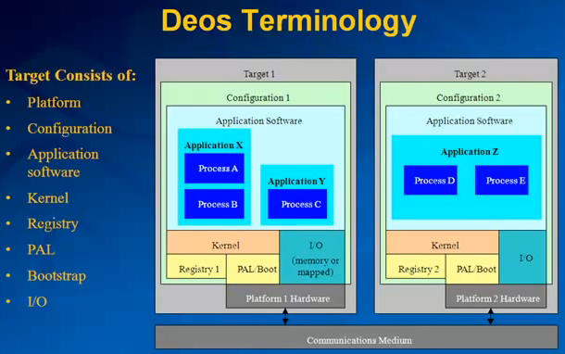

Slide 44
Multithreading
Multithreading is mainly found in multitasking operating systems.
Multithreading is a widespread programming and execution model that allows multiple threads to exist within the context of a single process.
These threads share the process's resources, but are able to execute independently.
The threaded programming model provides developers with a useful abstraction of concurrent execution.
Multithreading can also be applied to a single process to enable parallel execution on a multiprocessing system.

Slide 45
Advantage of Multithreaded Apps
Responsiveness
Faster Execution
Lower resource consumption
Better system utilization
Simplified sharing and communication
Parallelization

Slide 46
Responsiveness: Multi-threading has the ability for an application to remain responsive to input. In a single-threaded program, if the main execution thread blocks on a long-running task, the entire application can appear to freeze. By moving such long-running tasks to a worker thread that runs concurrently with the main execution thread, it is possible for the application to remain responsive to user input while executing tasks in the background. On the other hand, in most cases multithreading is not the only way to keep a program responsive, with non-blocking I/O and/or Unix signals being available for gaining similar results.
Faster execution: This advantage of a multithreaded program allows it to operate faster on computer systems that have multiple or multi-core CPUs, or across a cluster of machines, because the threads of the program naturally lend themselves to truly concurrent execution.

Slide 47
Lower resource consumption: Using threads, an application can serve multiple clients concurrently using less resource than it would need when using multiple process copies of itself. For example, the Apache HTTP server, which uses a pool of listener and server threads for listening to incoming requests and processing these requests.
Better system utilization: Multi-threaded applications can also utilize the system better. For example, a file-system using multiple threads can achieve higher throughput and lower latency since data in faster mediums like the cache can be delivered earlier while waiting for a slower medium to retrieve the data.

Slide 48
Simplified sharing and communication: Unlike processes, which require message passing or shared memory to perform inter-process communication, communication between threads is very simple. Threads automatically share the data, code and files and so, communication is vastly simplified.
Parallelization: Applications looking to utilize multi-core and multi-CPU systems can use multi-threading to split data and tasks into parallel sub-tasks and let the underlying architecture manage how the threads run, either concurrently on a single core or in parallel on multiple cores. GPU computing environments like CUDA and OpenCL use the multi-threading model where dozens to hundreds of threads run in parallel on a large number of cores.

Slide 49
Drawbacks of Multithreading
Synchronization: Since threads share the same address space, the programmer must be careful to avoid race conditions and other non-intuitive behaviors. In order for data to be correctly manipulated, threads will often need to rendezvous in time in order to process the data in the correct order. Threads may also require mutually exclusive operations (often implemented using semaphores) in order to prevent common data from being simultaneously modified or read while in the process of being modified. Careless use of such primitives can lead to deadlocks.
Thread crashes a process: An illegal operation performed by a thread crashes the entire process and so, one misbehaving thread can disrupt the processing of all the other threads in the application.

Slide 50
Inter process Communication & Synchronization
Race conditions
Critical Regions
Mutual Exclusion with busy waiting
Sleep and Wakeup
Semaphores
Introduction to message passing
The dining philosophers problem

Slide 51
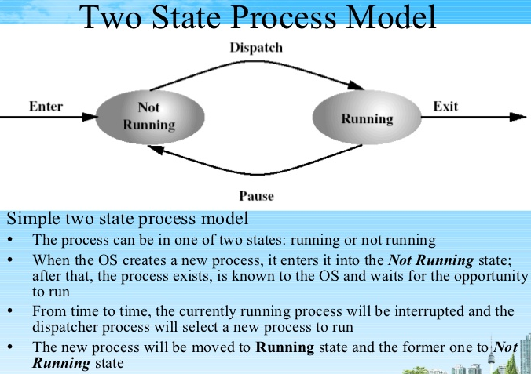

Slide 52
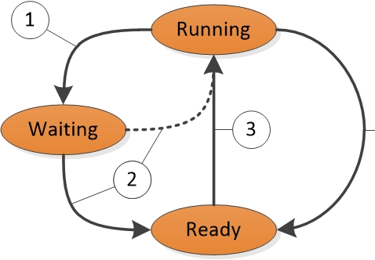
3 State

Slide 53
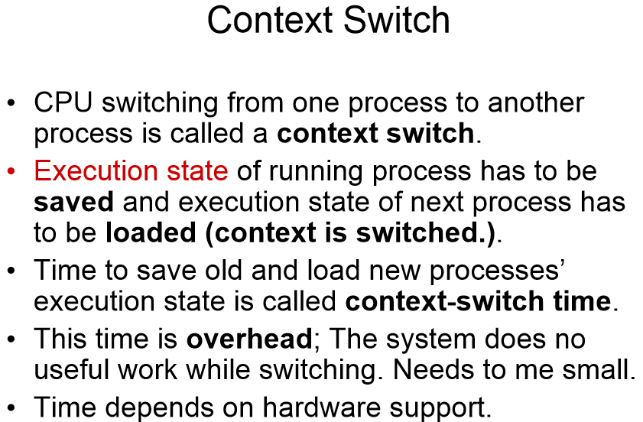

Slide 54
SUMMARY
To hide the effects of interrupts, operating systems provide a conceptual model of sequential processes running in parallel. Processes can be created and terminated dynamically. Each process has its own address space.
For some applications it is useful to have multiple threads of control within a single process. These threads are scheduled independently and each one has its own stack, but all threads in a process share a common address space. Threads can be implemented in user space or in the kernel.

Slide 55
Processes can communicate with one another using inter process communication primitives, such as semaphores, monitors or messages. These primitives are used to ensure that no two processes are ever in their critical regions at the same time, a situation that leads to chaos. A process can be running, runnable or blocked and can change state when it or another process executes one of the interprocess communication primitives. Inter thread communication is similar.

Slide 56
Inter process communication primitives can be used to solve such problems as the producer-consumer, dining philosophers and reader-writer. Even with these primitives, care has to be taken to avoid errors and deadlocks.
A great many scheduling algorithms have been studied. Some of these are batch systems , such as shortest job first scheduling. Others are common in both batch systems and interactive systems. These algorithms include round robin, priority scheduling, multilevel queues, guaranteed scheduling, lottery scheduling and fair-share scheduling. Some systems make a clean separation between the scheduling mechanism and the scheduling policy, which allows users to have control of the scheduling algorithm.

Slide 57
Process scheduling
Round Robin Scheduling
Priority Scheduling
Multiple Queues
Prepare Presentation in Process Management.
Prohibited: You are not supposed to use any of my slide components. (Sunday: Presentation)

